Slide 1


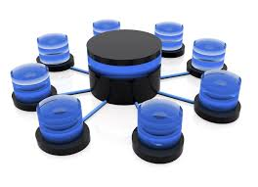

Web Services, SOA and REST
Services, Clients, SOAP, WSDL, XML, REST, RESTful Services, JSON
SoftUni Team
Technical Trainers
Software University
http://softuni.bg

Slide 2


Table of Contents
Distributed Apps, Web Services and Service-Oriented Architecture (SOA)
Enterprise Web Service Infrastructure, Standards and Protocols
SOAP, WSDL, HTTP, XML, WS-*, …
RESTful Web Services
Representational State Transfer (REST)
CRUD Operations and HTTP Methods
Postman – REST Client

Slide 3



Distributed Apps, Web Services and SOA

Slide 4
Distributed Applications
Most modern applications are distributed
Several components interact with each other
Distributed application models
"Client-Server" model – persistent socket / WebSocket connection
"Distributed Objects" model – client an server objects
DCOM, CORBA, Java RMI, .NET Remoting, …
Outdated, not used in modern apps
"Web Services" / "RESTful Web Services" model
RESTful (HTTP, REST, JSON) and heavy services (SOAP, WSDL, XML)

Slide 5

Services: Real World and Software
In the real world a "service" is:
A piece of work performed by a service provider
Takes some input and produces some desired results
E.g. a supermarket: pay some money and get some food
Has quality characteristics (price, execution time, constraints, etc.)
In the software world a "service"
Takes some input, performs some work, produces some output
Request-response model: client requests, server responses

Slide 6

Web Services and Clients
A "web service" is:
Software service that communicates over standard Web protocols
Classical (heavyweight) services use SOAP, WSDL, XML, WS-*
Lightweight (RESTful) services use HTTP, REST and JSON
A "client" (consumer) uses the services
Requests something to be performed
Gets the desired result
Or gets an error

Slide 7
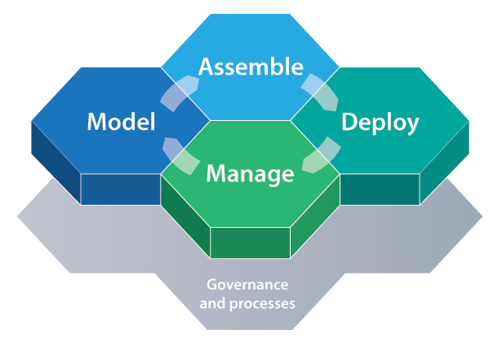
What is Service-Oriented Architecture (SOA)?
SOA (Service-Oriented Architecture) is an architectural concept for development of software systems
Using reusable building blocks (components) called "services"
SOA == decouple the monolithic software to reusable services
Services in SOA are:
Autonomous, stateless business functions
Accept requests and return responses
Use well-defined, standard interface (standard protocols)

Slide 8


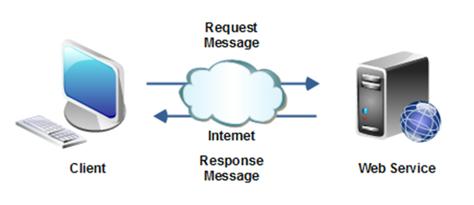
SOA Services
Autonomous
Each service operates autonomously
Without any awareness that other services exist
Stateless
Do not remember a durable state between requests
Easy to scale → just add more nodes
Request-response model
Client asks, server returns an answer
Server never sends requests to the client

Slide 9
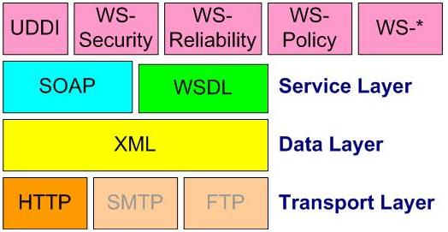
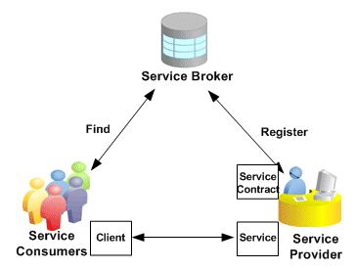
SOA Services (2)
Communication through standard protocols
HTTP, FTP, SMTP, RPC, MSMQ, ...
JSON, XML, SOAP, RSS, WS-*, ...
Platform independent
Independent of OS, platforms, languages, frameworks, …
Discoverable
Service registries and brokers

Slide 10

Lightweight SOA (SOA in Internet)
Internet companies implement lightweight SOA in Internet
Also called WOA (Web-Oriented Architecture)
Examples: Google, Amazon, Facebook, Twitter, Parse.com, ...
Based on lightweight Web standards:
AJAX and Rich Internet Applications (RIA)
REST, JSON, RSS, XML, proprietary APIs
RESTful Web services == lightweight Web services
Use simple HTTP requests and simple JSON responses

Slide 11
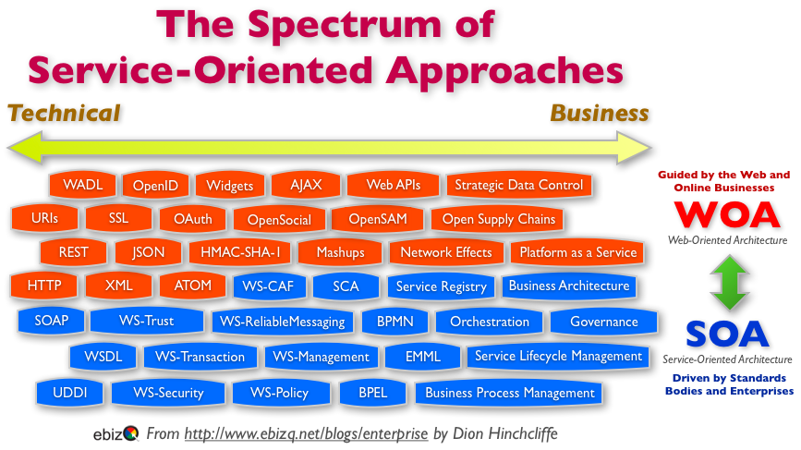
Heavyweight SOA (SOA in Enterprises)
Heavyweight SOA stacks
Driven by business processes: BPM, BPMN, BPEL, ...
Enterprise application integration (EAI)
B2B integration and SOA based portals
Unified Frameworks: SCA and WCF
Enterprise Service Bus (ESB)
SOA governance (control)
Many public standards like WS-*

Slide 12

Web Service Standards: WS-*
Service Discovery Standards
UDDI, RDDL, XRI, XRDS
Service Messaging Standards
SOAP, SOAP over JMS, MTOM, WS-Addressing
Service Meta-Data Standards
WSBPEL, WSDL, WADL, WSFL, WS-Policy, WS-PolicyAssertions, WS-PolicyAttachment, WS-MetadataExchange (WS-MEX)
Web Service Security Standards
XML-Signature, WS-SecurityPolicy, WS-Security, WS-Trust, WS-SecureConversation
Quality of Service Standards
WS-ReliableMessaging (WS-RM), WS-Coordination, WS-AtomicTransactions, WS-TX
https://www.oasis-open.org/standards

Slide 13
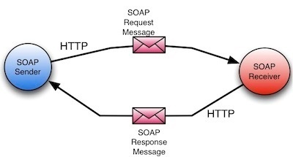
Enterprise Web Service Infrastructure
SOAP / WSDL / XML / HTTP

Slide 14
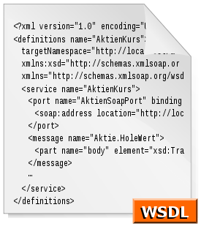
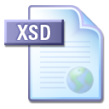

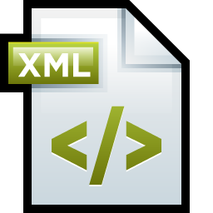

Heavyweight Web Services Infrastructure
Heavyweight (classical) Web service infrastructure components:
Description
WSDL (Web Service Definition Language)
Metadata
WS-MetadataExchange (WS-MEX), DISCO
Wire format
SOAP, XML, XSD
HTTP

Slide 15
WSDL Service Description (WSDL)
WSDL (Web Services Description Language)
Describes what a Web service can do
Names of the available methods (messages)
Input and output parameters, returned value
Data types used for parameters or result
Endpoints: ports and bindings
WSDL is an XML based, open standard from W3C

Slide 16
WSDL – Example
<?xml version="1.0" encoding="utf-8"?>
<definitions
xmlns:http="http://schemas.xmlsoap.org/wsdl/http/"
xmlns:soap="http://schemas.xmlsoap.org/wsdl/soap/"
xmlns:s="http://www.w3.org/2001/XMLSchema"
xmlns:s0="http://www.devbg.org/ws/MathService"
xmlns:soapenc="http://schemas.xmlsoap.org/soap/encoding/"
xmlns:tm="http://microsoft.com/wsdl/mime/textMatching/"
xmlns:mime="http://schemas.xmlsoap.org/wsdl/mime/"
targetNamespace="http://www.devbg.org/ws/MathService"
xmlns="http://schemas.xmlsoap.org/wsdl/">
<types> … </types>
<message name="AddSoapIn"> … </message>
<portType name="MathServiceSoap"> … </portType>
<binding name="MathServiceSoap" … > … </binding>
<service name="MathService"> … </service>
</definitions>

Slide 17
Discovery of Web Service
The process of getting the service metadata (description)
Usually a URL is interrogated to retrieve the metadata
Two protocols for interrogation
WS-MetadataExchange (WS-MEX)
Standardized protocol developed by Microsoft, Sun, SAP, …
DISCO
Old Microsoft protocol to use with the UDDI registry idea

Slide 18
SOAP – Request / Result Format
SOAP (Simple Object Access Protocol)
Open XML based format for sending messages
Open standard from W3C
A SOAP message consists of:
SOAP header – describes the message parameters (metadata)
SOAP body – the message data (request or response body)
Typically SOAP messages are sent over HTTP
Optionally TCP / message queue / other channels can be used

Slide 19
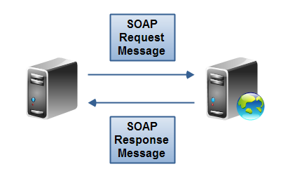
SOAP Request – Example
<?xml version="1.0" encoding="utf-8"?>
<soap:Envelope xmlns:xsi="http://www.w3.org/2001/XMLSchema-instance"
xmlns:xsd="http://www.w3.org/2001/XMLSchema"
xmlns:soap="http://schemas.xmlsoap.org/soap/envelope/">
<soap:Body>
<CalcDistance xmlns="http://www.devbg.org/Calc">
<startPoint>
<x>4</x> <y>5</y>
</startPoint>
<endPoint>
<x>7</x> <y>-3</y>
</endPoint>
</CalcDistance>
</soap:Body>
</soap:Envelope>

Slide 20
SOAP Response – Example
<?xml version="1.0" encoding="utf-8"?>
<soap:Envelope
xmlns:xsi="http://www.w3.org/2001/XMLSchema-instance"
xmlns:xsd="http://www.w3.org/2001/XMLSchema"
xmlns:soap="http://schemas.xmlsoap.org/soap/envelope/">
<soap:Body>
<CalcDistanceResponse
xmlns="http://www.devbg.org/Calc/">
<CalcDistanceResult>8.54400374531753</CalcDistanceResult>
</CalcDistanceResponse>
</soap:Body>
</soap:Envelope>

Slide 21
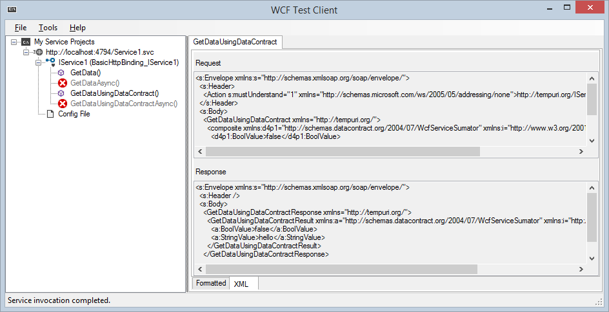
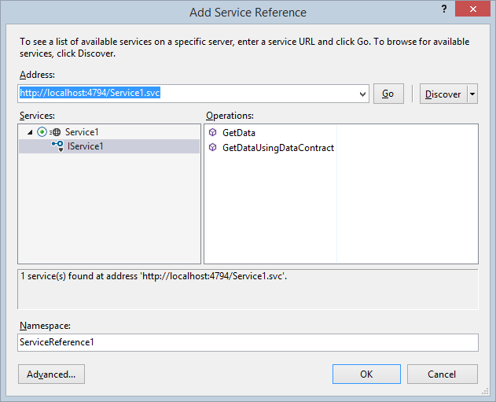
Heavyweight Web Services (Based on SOAP and WSDL)
Live Demo

Slide 22
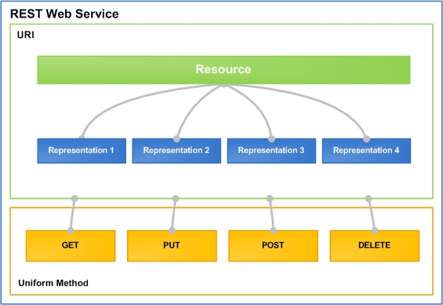
RESTful Web Services
Lightweight Architecture for Web Services

Slide 23
What is REST?
"Representational State Transfer (REST) is a software architecture style consisting of guidelines and best practices for creating scalable Web services."
http://en.wikipedia.org/wiki/Representational_State_Transfer
Application state and functionality are resources
Every resource is associated with unique URI
Each resource supports standard operations (CRUD)
This natively maps to the HTTP protocol
HTTP methods: GET, POST, PUT, DELETE, PATCH, OPTIONS, …

Slide 24
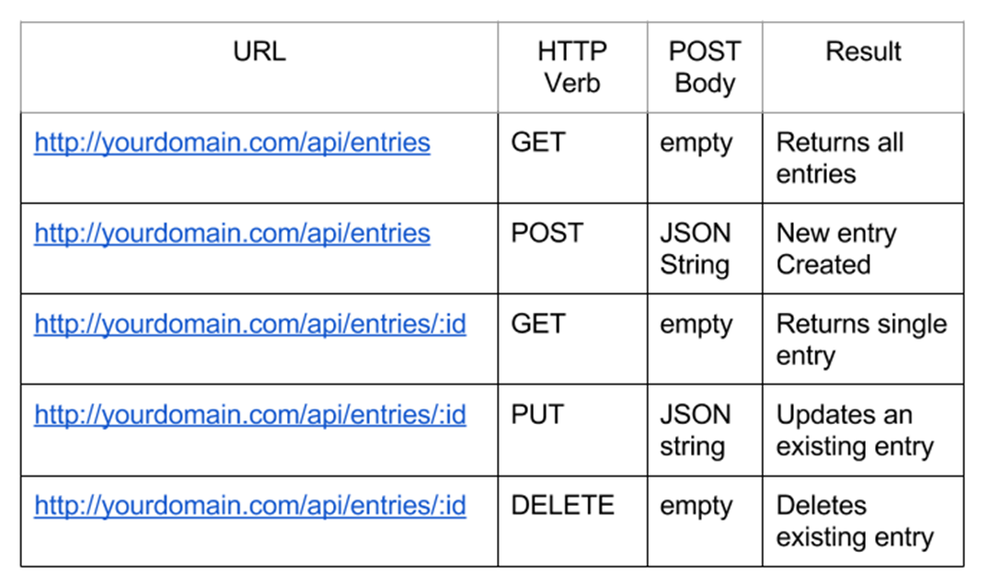
CRUD Operations in REST APIs

Slide 25
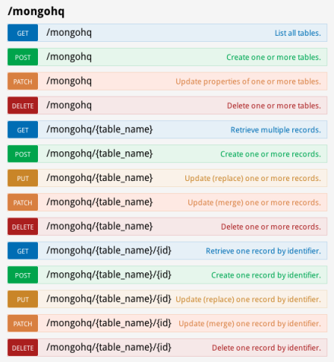
RESTful Web Services and HTTP Methods
One URI per resource
Multiple operations per URI
Get all resources / single resource by ID
GET http://myservice.com/api/Books
GET http://myservice.com/api/Books/3
Add a new resource
POST http://myservice.com/api/Books
Modify (update) a resource
PUT http://myservice.com/api/Books/3

Slide 26
RESTful Web Services and HTTP Methods (2)
Delete (remove) a resource
DELETE http://myservice.com/api/Books/3
Update a resource partially
PATCH http://myservice.com/api/Books/3
Retrieve resource meta-data
HEAD http://myservice.com/api/Books/3
Inspect resource (typically used in AJAX to request permissions)
OPTIONS http://myservice.com/api/Books/3

Slide 27
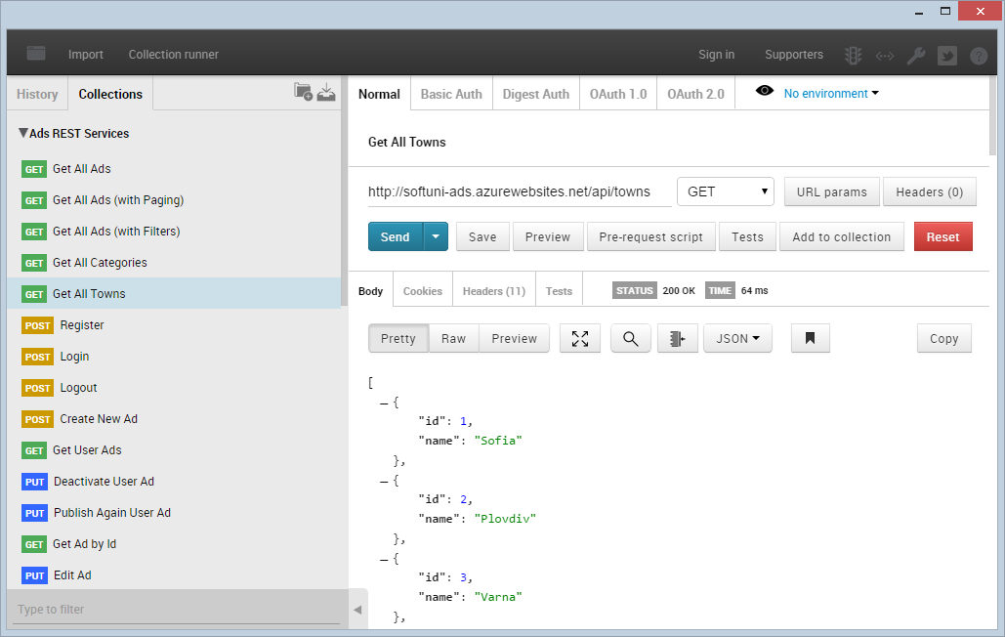
Postman – REST Client

Slide 28
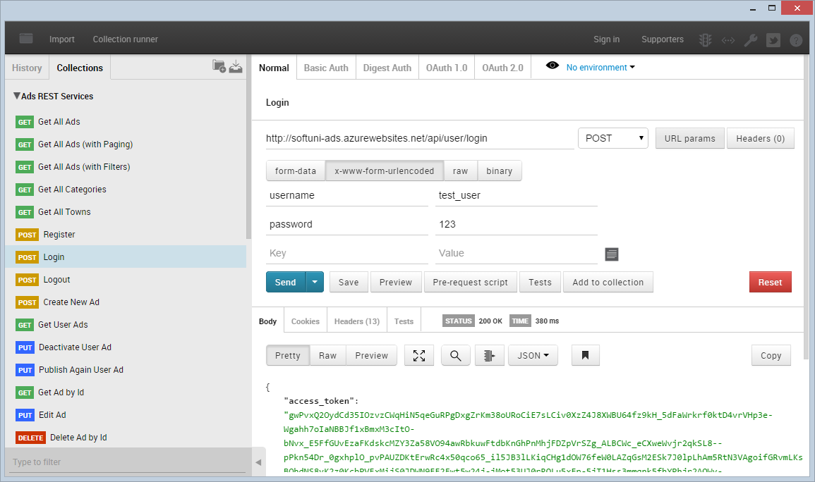
Postman
Live Demo

Slide 29
RESTful API – Example
Server
Web Client (JavaScript and jQuery)
Auth
$.post("api/register", credentials, 'json');
Register
$.post("api/login", credentials, 'json');
Login
$.getJSON("api/users");
Operations
Desktop / Mobile Client (C# / Java / PHP)
Users
Add User
var request = HttpRequest.create("api/users");
response = request.getResponse();
// Parse the response to C# objects
Remove User

Slide 30
RESTful Web Services
Live Demo

Slide 31

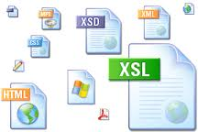

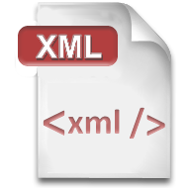


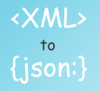

XML, JSON, RSS, Atom
Comparing the Common Service Data Formats

Slide 32
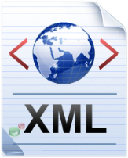
XML
XML is markup-language for data representation
Used for encoding documents in machine-readable form
Text-based format, consists of tags, attributes and content
Provide data and meta-data in the same time
<?xml version="1.0"?>
<library>
<book><title>HTML 5</title><author>Bay Ivan</author></book>
<book><title>WPF 4</title><author>Microsoft</author></book>
<book><title>WCF 4</title><author>Kaka Mara</author></book>
<book><title>UML 2.0</title><author>Bay Ali</author></book>
</library>

Slide 33
JSON
JSON (JavaScript Object Notation)
Standard for representing data structures and associative arrays
Lightweight text-based open standard
Derived from the JavaScript language
{
"firstName": "John", "lastName": "Smith", "age": 25,
"address": { "streetAddress": "17 Tintyava Str.",
"city": "Sofia", "postalCode": "1113" },
"phoneNumber": [{ "type": "home", "number": "212 555-1234"},
{ "type": "fax", "number": "646 555-4567" }]
},
{ "firstName": "Bay", "lastName": "Ivan", "age": 79 }

Slide 34

RSS / Atom
RSS (Really Simple Syndication)
Family of Web feed formats for accessing site publications
E.g. blog entries, news headlines, videos, etc.
Based on XML, with standardized XSD schema
RSS documents (feeds) are list of items
Each containing title, author, publish date, summarized text, and metadata
Atom protocol aimed to enhance RSS and allows publishing

Slide 35
RSS – Example
<?xml version="1.0" encoding="utf-8" ?>
<rss version="2.0">
<channel>
<title>W3Schools Home Page</title>
<link>http://www.w3schools.com</link>
<description>Free web building tutorials</description>
<item>
<title>RSS Tutorial</title>
<link>http://www.w3schools.com/rss</link>
<description>New RSS tutorial on W3Schools</description>
</item>
<item>
<title>XML Tutorial</title>
<link>http://www.w3schools.com/xml</link>
<description>New XML tutorial on W3Schools</description>
</item>
</channel>
</rss>

Slide 36









Web Services and Cloud
https://softuni.bg/courses/web-services-and-cloud/

Slide 37
License
This course (slides, examples, demos, videos, homework, etc.) is licensed under the "Creative Commons Attribution-NonCommercial-ShareAlike 4.0 International" license
Attribution: this work may contain portions from
"Web Services and Cloud" course by Telerik Academy under CC-BY-NC-SA license

Slide 38





Free Trainings @ Software University
Software University Foundation – softuni.org
Software University – High-Quality Education, Profession and Job for Software Developers
softuni.bg
Software University @ Facebook
facebook.com/SoftwareUniversity
Software University @ YouTube
youtube.com/SoftwareUniversity
Software University Forums – forum.softuni.bg

